Slide 1





Functions and Stored Procedures
Creating and Using Functions, Stored Procedures
Databases
Basics
SoftUni Team
Technical Trainers
Software University
http://softuni.bg

Slide 2




Table of Contents
Functions
Basic definition
Types of Functions
Syntax
Stored Procedures
Stored Procedure Execution
Altering, Dropping Procedures
Parameters

Slide 3
Questions
sli.do #CSharpDB

Slide 4


User-Defined Functions
Definition, Usage, Syntax

Slide 5

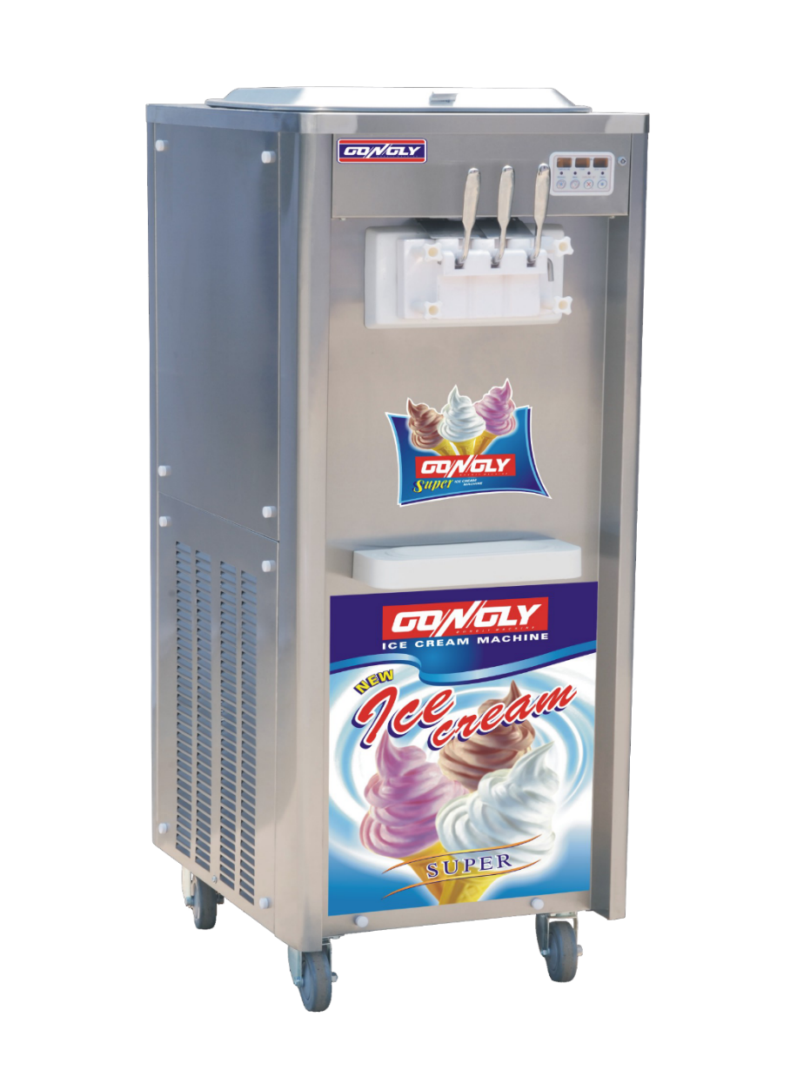





Functions: Basic Definition
At its core, a function receives input and produces output

Slide 6
Types of User-Defined Functions
Scalar functions (like SQRT(…)).
Similar to the built-in functions
Return a single value
Table-valued functions.
Similar to a view with parameters
Return a table as a result of single SELECT statement
Aggregate functions (like SUM(…))
Perform calculation over set of inputs values.
Defined through external .NET functions.

Slide 7
Create Functions
CREATE FUNCTION udf_ProjectDurationWeeks (@StartDate DATETIME, @EndDate DATETIME)
RETURNS INT
AS
BEGIN
DECLARE @projectWeeks INT;
IF(@EndDate IS NULL)
BEGIN
SET @EndDate = GETDATE()
END
SET @projectWeeks = DATEDIFF(WEEK, @StartDate, @EndDate)
RETURN @projectWeeks;
END
Function Name
Parameters
Return Type
Variable
IF Statement
Return Value

Slide 8
Execute Functions
Functions are called using schemaName.functionName
Call the Function
SELECT [ProjectID],
[StartDate],
[EndDate],
dbo.udf_ProjectDurationWeeks([StartDate],[EndDate])
AS ProjectWeeks
FROM [SoftUni].[dbo].[Projects]
ProjectID | StartDate | EndDate | ProjectWeeks
1 | 2016-09-01 | 2016-10-07 | 5
2 | 2016-10-01 | 2016-10-07 | 1
3 | 2015-10-07 | NULL | 52

Slide 9
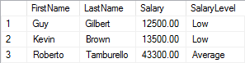

Problem: Salary Level Function
Write a function ufn_GetSalaryLevel(@salary MONEY) that receives salary of an employee and returns the level of the salary.
If salary is < 30000 return “Low”
If salary is between 30000 and 50000 (inclusive) return “Average”
If salary is > 50000 return “High”
Check your solution here: https://judge.softuni.bg/Contests/Practice/Index/302#4

Slide 10
Solution: Salary Level Function (1)
Input Parameters
Function Name
CREATE FUNCTION ufn_GetSalaryLevel(@salary INT)
RETURNS NVARCHAR(10)
AS
BEGIN
-- Function logic here.
END;
Return Type
Function Body
Check your solution here: https://judge.softuni.bg/Contests/Practice/Index/302#4

Slide 11
Solution: Salary Level Function (2)
Variable
DECLARE @salaryLevel VARCHAR(10)
IF (@salary < 30000)
SET @salaryLevel = 'Low'
ELSE IF(@salary >= 30000 AND @salary <= 50000)
SET @salaryLevel = 'Average'
ELSE
SET @salaryLevel = 'High'
RETURN @salaryLevel
IF Statement
Return Result
Check your solution here: https://judge.softuni.bg/Contests/Practice/Index/302#4

Slide 12

Stored Procedures

Slide 13
What are Stored Procedures?
Stored procedures are named sequences of T-SQL statements.
Encapsulate repetitive program logic
Can accept input parameters
Can return output results
Benefits of stored procedures
Share application logic
Improved performance
Reduced network traffic

Slide 14
Creating Stored Procedures
Syntax: CREATE PROCEDURE … AS …
Example:
USE SoftUni
GO
CREATE PROC dbo.usp_SelectEmployeesBySeniority
AS
SELECT *
FROM Employees
WHERE DATEDIFF(Year, HireDate, GETDATE()) > 5
GO
Procedure Name
Procedure Logic

Slide 15
Executing Stored Procedures
Executing a stored procedure by EXEC.
Executing a stored procedure within an INSERT statement.
EXEC usp_SelectEmployeesBySeniority
INSERT INTO Customers
EXEC usp_SelectEmployeesBySeniority

Slide 16
Altering Stored Procedures
Use the ALTER PROCEDURE statement
USE SoftUni
GO
ALTER PROC usp_SelectEmployeesBySeniority
AS
SELECT FirstName, LastName, HireDate,
DATEDIFF(Year, HireDate, GETDATE()) as Years
FROM Employees
WHERE DATEDIFF(Year, HireDate, GETDATE()) > 5
ORDER BY HireDate
GO
Procedure Name

Slide 17
Dropping Stored Procedures
DROP PROCEDURE
You could check if any objects depend on the stored procedure by executing the system stored procedure sp_depends
DROP PROC usp_SelectEmployeesBySeniority
EXEC sp_depends 'usp_SelectEmployeesBySeniority'

Slide 18

Stored Procedures
Using Parameters

Slide 19
Defining Parameterized Procedures
To define a parameterized procedure use the syntax:
Choose the parameter types carefully and provide appropriate default values
CREATE PROCEDURE usp_ProcedureName
[(@parameter1Name parameterType,
@parameter2Name parameterType,…)] AS
CREATE PROC usp_SelectEmployeesBySeniority(
@minYearsAtWork int = 5) AS
…

Slide 20
Parameterized Stored Procedures – Example
Procedure Name
CREATE PROC usp_SelectEmployeesBySeniority(@minYearsAtWork int = 5)
AS
SELECT FirstName, LastName, HireDate,
DATEDIFF(Year, HireDate, GETDATE()) as Years
FROM Employees
WHERE DATEDIFF(Year, HireDate, GETDATE()) > @minYearsAtWork
ORDER BY HireDate
GO
EXEC usp_SelectEmployeesBySeniority 10
EXEC usp_SelectEmployeesBySeniority
Procedure Logic
Usage

Slide 21
Passing Parameter Values
Passing values by parameter name
Passing values by position
EXEC usp_AddCustomer
@customerID = 'ALFKI',
@companyName = 'Alfreds Futterkiste',
@address = 'Obere Str. 57',
@city = 'Berlin',
@phone = '030-0074321'
EXEC usp_AddCustomer 'ALFKI2', 'Alfreds Futterkiste', 'Obere Str. 57', 'Berlin', '030-0074321'

Slide 22
Returning Values Using OUTPUT Parameters
CREATE PROCEDURE dbo.usp_AddNumbers
@firstNumber SMALLINT,
@secondNumber SMALLINT,
@result INT OUTPUT
AS
SET @result = @firstNumber + @secondNumber
GO
DECLARE @answer smallint
EXECUTE usp_AddNumbers 5, 6, @answer OUTPUT
SELECT 'The result is: ', @answer
-- The result is: 11
Creating procedure
Executing procedure
Display results

Slide 23
Problem: Employees with Three Projects
Create a procedure that assigns projects to employee.
If the employee has more than 3 projects, throw exception and rollback the changes
EmployeeID | ProjectID
1 | 5
1 | 6
2 | 6
2 | 7
2 | 8
Check your solution here: https://judge.softuni.bg/Contests/Practice/Index/302#8

Slide 24
Solution: Employees with Three Projects (1)
Procedure Name
CREATE PROCEDURE udp_AssignProject (@EmployeeID INT, @ProjectID INT)
AS
BEGIN
DECLARE @maxEmployeeProjectsCount INT = 3
DECLARE @employeeProjectsCount INT
SET @employeeProjectsCount =
(SELECT COUNT(*)
FROM [dbo].[EmployeesProjects] AS ep
WHERE ep.EmployeeId = @EmployeeID)
-- Transaction here.
END
Parameters
Declare Variables
Check your solution here: https://judge.softuni.bg/Contests/Practice/Index/302#10

Slide 25
Solution: Employees with Three Projects (2)
BEGIN TRAN
INSERT INTO [dbo].[EmployeesProjects] (EmployeeID, ProjectID) VALUES (@EmployeeID, @ProjectID)
IF(@employeeProjectsCount >= @maxEmployeeProjectsCount)
BEGIN
RAISERROR('The employee has too many projects!', 16, 1)
ROLLBACK
END
ELSE
COMMIT
Undo Changes
Throw Exception
Save Changes
Check your solution here: https://judge.softuni.bg/Contests/Practice/Index/302#8

Slide 26

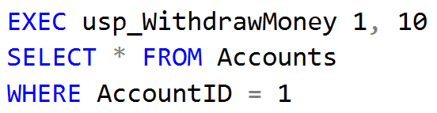
Problem: Withdraw Money
Create a stored procedure usp_WithdrawMoney (AccountId, moneyAmount) that operate in transactions.
Validate only if the account exists and if not, throw an exception.
Check your solution here: https://judge.softuni.bg/Contests/Practice/Index/302#14

Slide 27
Solution: Withdraw Money (1)
Procedure Name
CREATE PROCEDURE usp_WithdrawMoney @account INT, @moneyAmount MONEY
AS
BEGIN
-- Transaction logic goes here.
END
Parameters
Check your solution here: https://judge.softuni.bg/Contests/Practice/Index/302#14

Slide 28
Solution: Withdraw Money (2)
Update Balance
BEGIN TRANSACTION
UPDATE Accounts SET Balance = Balance - @moneyAmount
WHERE Id = @account
IF @@ROWCOUNT <> 1
BEGIN
ROLLBACK;
RAISERROR('Invalid account!', 16, 1)
RETURN
END
COMMIT
Rollback
Save changes
Check your solution here: https://judge.softuni.bg/Contests/Practice/Index/302#14

Slide 29
Summary
Functions allow for complex calculations
Usually return a scalar value
Stored Procedures allow us to save time by
Shortening code
Simplifying complex tasks
CREATE FUNCTION f_ProcedureName RETURNS …
AS
…
CREATE PROC usp_ProcedureName AS …
Notes:
We can create user defined functions and stored procedures in SQL Server and we can easily execute them to save code repetition.
We can create triggers that apply a given behavior when some condition has occurred.
We can make transactions if we want to be sure that if all the behavior goes as planned, all the changes are made and in the other case, no changes are applied.

Slide 30







Functions and Stored Procedures
https://softuni.bg/courses/databases-sqlsrv

Slide 31
License
This course (slides, examples, demos, videos, homework, etc.) is licensed under the "Creative Commons Attribution-NonCommercial-ShareAlike 4.0 International" license
Attribution: this work may contain portions from
"Databases" course by Telerik Academy under CC-BY-NC-SA license

Slide 32





Trainings @ Software University (SoftUni)
Software University – High-Quality Education, Profession and Job for Software Developers
softuni.bg
Software University Foundation
http://softuni.foundation/
Software University @ Facebook
facebook.com/SoftwareUniversity
Software University Forums
forum.softuni.bg

